Slide 1

Introduction to Cloud
Amazon web services

Slide 2
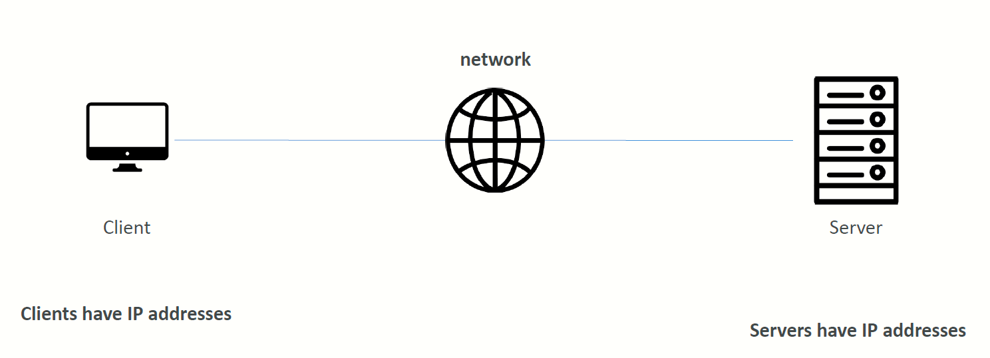
How Websites Work ?
A server is a computer, a device or a program that is dedicated to managing network resources.
They are called that because they “serve” another computer, device, or program called “client” to which they provide functionality.

Slide 3




What is a server composed of?
Compute: CPU
Memory: RAM
Storage: Data
Database: Store data in a structured way
Network: Routers, switch, DNS server

Slide 4
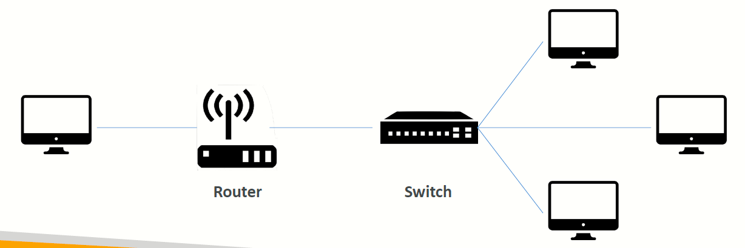
IT Terminology
Network: cables, routers and servers connected with each other
Router: A networking device that forwards data packets between computer networks. They know where to send your packets on the internet!
Switch: Takes a packet and send it to the correct server / client on your network

Slide 5
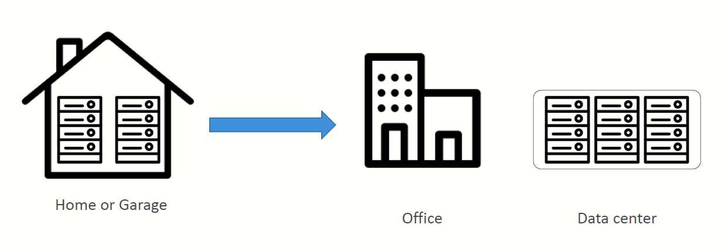
Traditionally, how to build infrastructure

Slide 6
Problems with traditional IT approach
Pay for the rent for the data center
Pay for power supply, cooling, maintenance
Adding and replacing hardware takes time
Scaling is limited
Hire 24/7 team to monitor the infrastructure
How to deal with disasters? (earthquake, power shutdown, fire…)
Can we externalize all this?

Slide 7
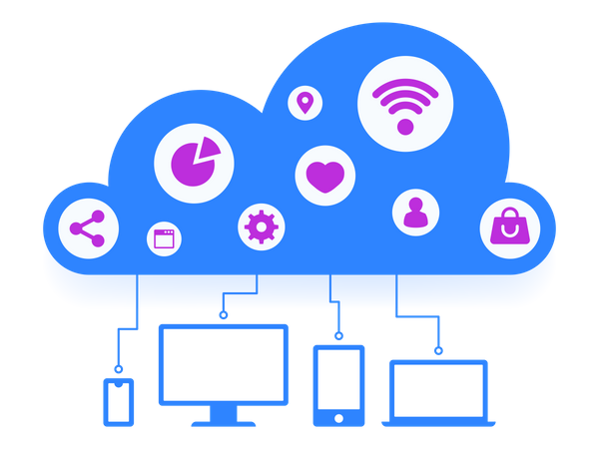
What is Cloud?
"The cloud" refers to the servers that are accessed over the Internet, and the software and databases that run on those servers.
Cloud servers are located in data centers all over the world.
By using cloud computing, users and companies do not have to manage physical servers themselves or run software applications on their own machines.

Slide 8
What is Cloud Computing?
Cloud computing is the on-demand delivery of compute power, database storage, applications, and other IT resources
Through a cloud services platform with pay-as-you-go pricing
You can provision exactly the right type and size of computing resources you need
You can access as many resources as you need, almost instantly
Simple way to access servers, storage, databases and a set of application services
Amazon Web Services owns and maintains the network-connected hardware required for these application services, while you provision and use what you need via a web application.

Slide 9
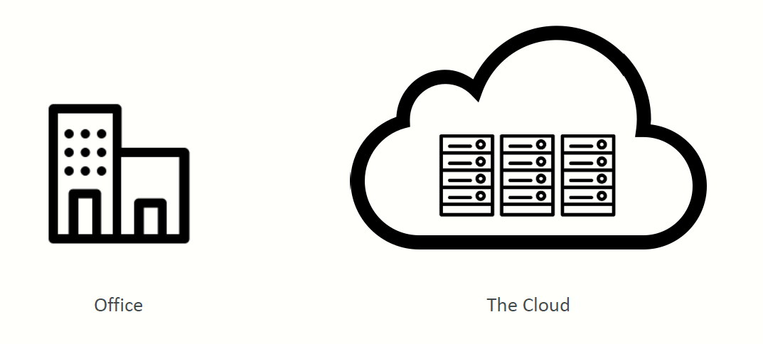
Tradition Infra vs Cloud

Slide 10
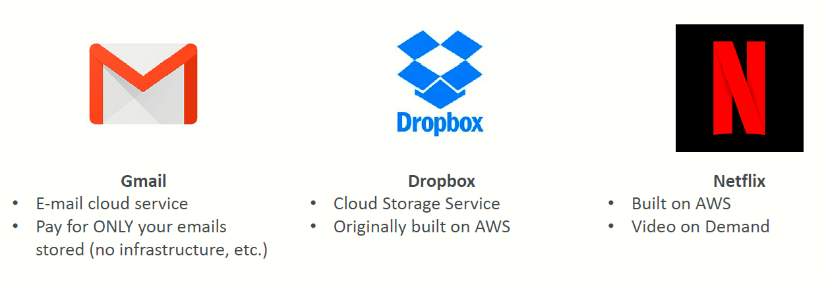
You’ve been using some Cloud services

Slide 11

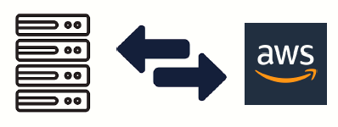
Deployment Models of the Cloud
Private Cloud:
Cloud services used by a single organization, not exposed to the public.
Complete control
Security for sensitive applications
Meet specific business needs
Public Cloud:
Cloud resources owned and operated by a third-party cloud service provider delivered over the Internet.
Six Advantages of Cloud Computing
Meet specific business needs
Hybrid Cloud:
Keep some servers on premises and extend some capabilities to the Cloud
Control over sensitive assets in your private infrastructure
Flexibility and cost effectiveness of the public cloud

Slide 12
Characteristics of Cloud Computing
On-demand self service:
Users can provision resources and use them without human interaction from the service provider
Broad network access:
Resources available over the network, and can be accessed by diverse client platforms
Multi-tenancy and resource pooling:
Multiple customers can share the same infrastructure and applications with security and privacy
Multiple customers are serviced from the same physical resources
Rapid elasticity and scalability:
Automatically and quickly acquire and dispose resources when needed
Quickly and easily scale based on demand
Measured service:
Usage is measured, users pay correctly for what they have used

Slide 13
Advantages of Cloud Computing
Trade capital expense (CAPEX) for operational expense (OPEX)
Pay On-Demand: don’t own hardware
Reduced Total Cost of Ownership (TCO) & Operational Expense (OPEX)
Benefit from massive economies of scale
Prices are reduced as AWS is more efficient due to large scale
Stop guessing capacity
Scale based on actual measured usage
Increase speed and agility
Stop spending money running and maintaining data centers
Go global in minutes: leverage the AWS global infrastructure

Slide 14
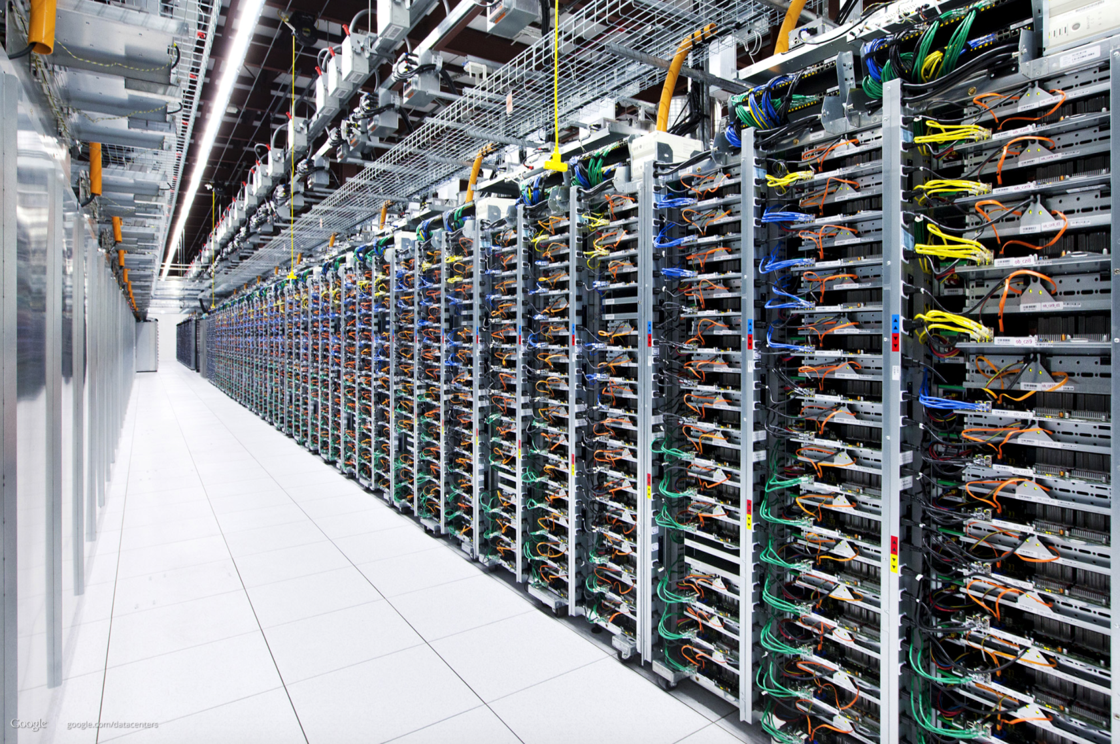
Fig. Cloud Servers in a data centre

Slide 15
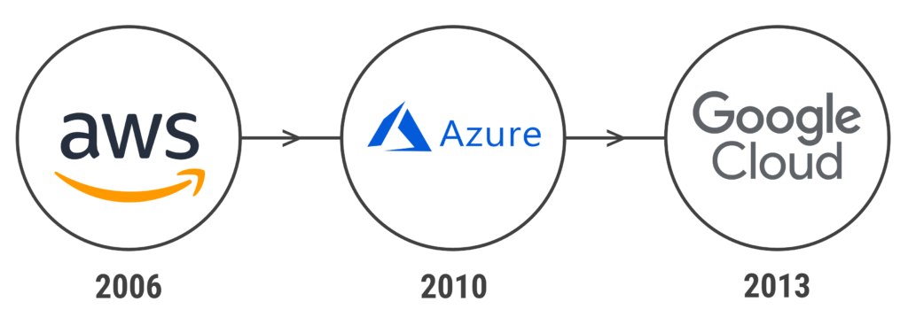
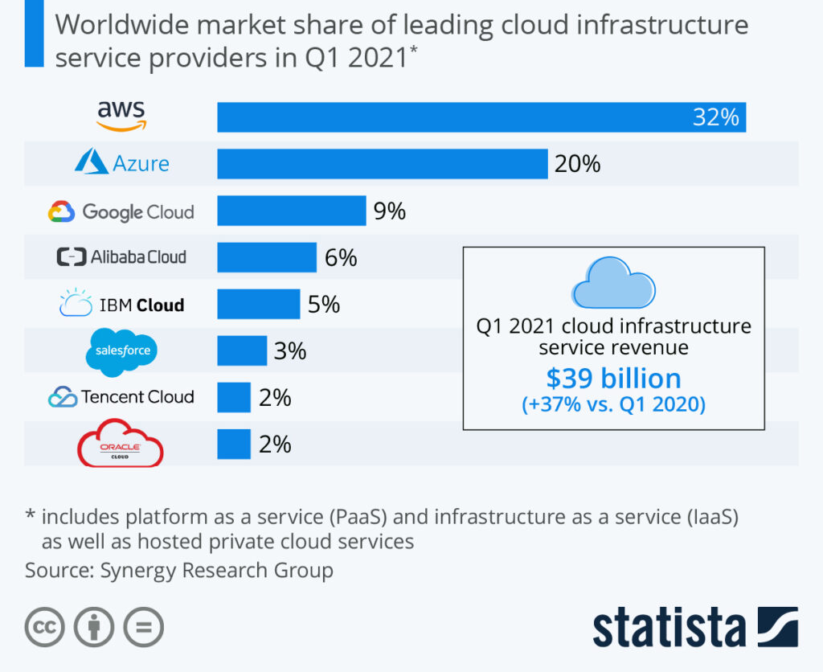
Cloud Providers
Cloud computing didn’t become a mainstream reality and a popular term until the first decade of the 21st century.
This decade saw the launch of cloud services like Amazon’s Elastic Compute (EC2) and Simple Storage Service (S3) in 2006, Heroku in 2007, Google Cloud Platform in 2008, Alibaba Cloud in 2009, Windows Azure (now Microsoft Azure).

Slide 16

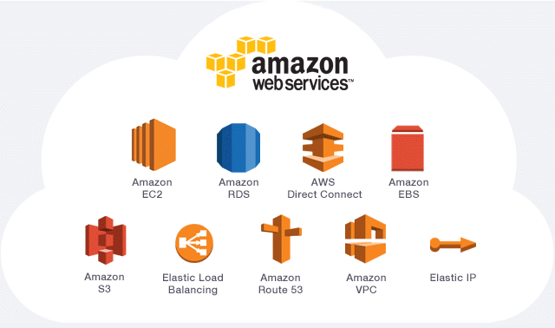
AWS(Amazon Web Services)
The current market leader of the cloud computing platforms, Amazon Web Services is a subsidiary of Amazon.com, Inc.
AWS is the most mature cloud platform offering a wide range of services to practically everyone: individual developers, large enterprises, and even governments.
AWS started its life as an internal cloud offering. By 2006, it had evolved into a publicly available cloud platform with services like Amazon S3 cloud storage and elastic compute cloud (EC2).
AWS now offers more than 200 fully featured services to cater to any demand and serve millions of users.

Slide 17
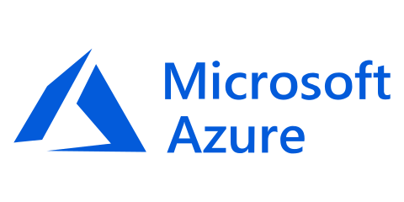
Microsoft Azure
Microsoft Azure is the second-largest cloud platform. Debuting in 2010, Azure has evolved into a cloud platform with more than 200 products and services. Today, it is among the fastest-growing cloud platforms.
As Microsoft offers Azure, it provides a wide array of services tailored particularly for Microsoft-centric enterprises—making the switch to a cloud or a hybrid-cloud environment smooth for many organizations.
In use by more than 95% of Fortune 500 companies, Microsoft Azure has a proven track record in catering to enterprise users.

Slide 18
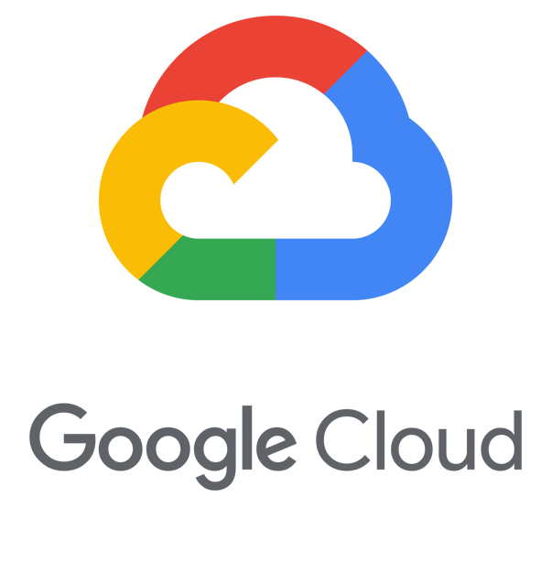
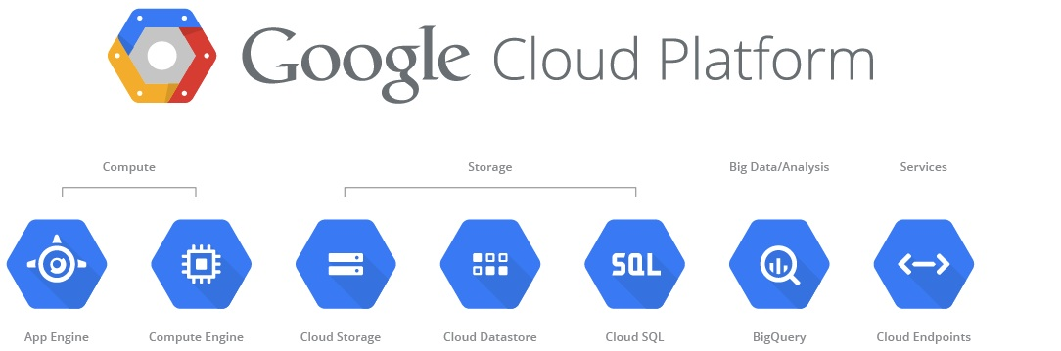
Google Cloud Platform (GCP)
The Google Cloud Platform is the cloud offering by none other than Google. GCP is part of the overarching Google Cloud.
Available to the general public beginning in 2010, the Google Cloud Platform currently offers over 100 services spanning computing, networking, big data, and more.
Compared to AWS and Azure, GCP is the smallest of the Big 3 cloud providers. Yet it offers a robust set of cloud services to power and support any kind of application.

Slide 19
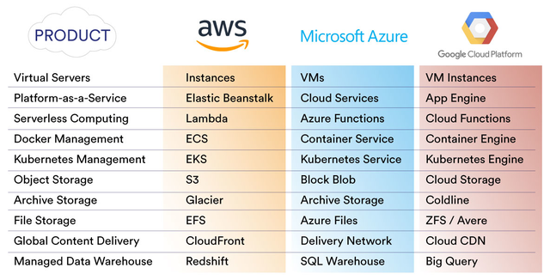
Services List

Slide 20
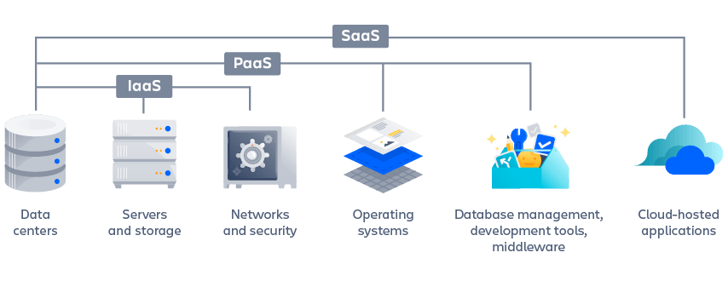
Cloud Delivery Models
There are the following three types of cloud service models
Infrastructure as a Service (IaaS)
Platform as a Service (PaaS)
Software as a Service (SaaS)
IaaS : AWS EC2,
GCP VM
PaaS : GitHub,
Kubernetes
SaaS : Facebook,
Netflix, Zoom

Slide 21
Infrastructure as a service (IaaS)
Infrastructure as a service (IaaS) is a cloud computing offering in which a vendor provides users access to computing resources such as storage, networking, and servers.
Organizations use their own platforms and applications within a service provider’s infrastructure.
Key features:
Instead of purchasing hardware outright, users pay for IaaS on demand.
Infrastructure is scalable depending on processing and storage needs.
Saves enterprises the costs of buying and maintaining their own hardware.
Because data is on the cloud, there can be no single point of failure.
Enables the virtualization of administrative tasks, freeing up time for other work.

Slide 22
Platform as a service (PaaS)
Platform as a service (PaaS) is a cloud computing offering that provides users with a cloud environment in which they can develop, manage, and deliver applications.
In addition to storage and other computing resources, users are able to use a suite of prebuilt tools to develop, customize, and test their own applications.
Key features:
PaaS provides a platform with tools to test, develop, and host applications in the same environment.
Enables organizations to focus on development without having to worry about underlying infrastructure.
Providers manage security, operating systems, server software and backups.
Facilitates collaborative work even if teams work remotely.

Slide 23
Software as a service (SaaS)
Software as a service (SaaS) is a cloud computing offering that provides users with access to a vendor’s cloud-based software.
Users do not install applications on their local devices. Instead, the applications reside on a remote cloud network accessed through the web or an API.
Through the application, users can store and analyze data and collaborate on projects.
Key features:
SaaS vendors provide users with software and applications via a subscription model.
Users do not have to manage, install or upgrade software; SaaS providers manage this.
Data is secure in the cloud; equipment failure does not result in loss of data.
Use of resources can be scaled depending on service needs.
Applications are accessible from almost any internet-connected device, from virtually anywhere in the world.

Slide 24
How to Choose CS Provider?
Factors to be considered before choosing a Cloud Services Provider (CSP)
Regions and availability:
Edge Locations (EL) and Availability Zones (AZ) are AWS Data Centers
EL are primarily used for caching of the data to provide better user experience with low latency, the AZ are used for hosting servers, websites, applications, software, Big Data processing, analytics and a wide variety of use cases.
Common Services:
all three providers offer comparable services to cover the common computing needs of users. However, there are basic differences in two general categories:
How each service is implemented in its cloud platform
The individual features available for each service
Specialized services
There is significant difference in the specialized services available among AWS, Azure and GCP
Pricing

Slide 25
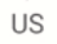
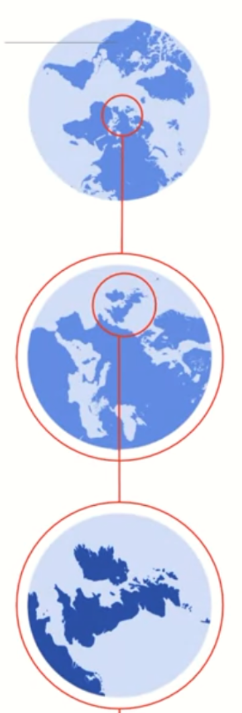

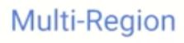
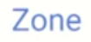
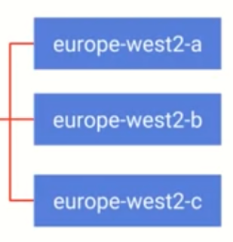

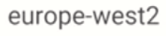
Regions and availability
Amazon Web Service
25 geographic regions with 81 availability zones.
218+ edge locations
12 Regional Edge Caches.
Microsoft Azure
60+ regions with a minimum of three availability zones in each region
more than 116 edge locations (Points of Presence).
Google Cloud Platform
27 cloud regions with 82 zones
146 edge locations.

Slide 26
Common Services
AWS and Azure have the largest service catalogs by offering more than 200+ services. GCP currently offers around 100+ services. A general breakdown of services is:
AWS has the largest catalog of services.
Azure is a close second with an impressive set of AI, ML, and analytics services.
Google Cloud Platform comes in third place for the number of services offered.
Categorize of common services
Compute Services
Database & Storage Services
Networking

Slide 27
1. Compute Services
SERVICE | AWS | AZURE | GCP
VM (Compute Instance) | EC2 (Elastic Compute) | Azure Virtual Machine | Google Compute Engine
PaaS | AWS Elastic Beanstalk | App Service | Google App Engine
Container | AWS Elastic Container/Kubernetes Service | Azure Kubernetes Service (AKS) | Google Kubernetes Engine
Serverless Functions | AWS Lambda | Azure Function | Google Cloud Functions

Slide 28
2. Database & Storage Services
SERVICE | AWS | AZURE | GCP
RDBMS (Multiple Database Types – SQL, MySQL, etc..) | AWS RDS | Azure SQL/ Database for MySQL/PostgreSQL | Cloud SQL
NoSQL | DynamoDB, Simple DB | Azure Cosmos DB, Table Storage | BigTable, Cloud Datastore
Object Storage | S3 (Simple Storage Service) | Blob Storage | Google Cloud Storage
File Storage | Elastic File System | Azure File Storage | Google Filestore
Archive Storage | Amazon Glacier | Azure Archive Storage | Google Storage (Archive Storage)
Data Warehouse/Data Lake | Amazon Redshift | Azure Synapse Analytics | Google BigQuery

Slide 29
3. Networking
SERVICE | AWS | AZURE | GCP
Virtual Network | Virtual Private Cloud (VPC) | Virtual Network (Vnet) | Virtual Private Cloud (VPC)
Load Balancing | Elastic Load Balancer | Azure Load Balancer | Google Cloud Load Balancing
Firewall | AWS Firewall / Web Application Firewall | Azure Firewall | Google Cloud firewalls
DNS | Route 53 | Azure DNS | Google Cloud DNS
CDN | Amazon CloudFront | Azure Content Delivery Network (CDN) | Cloud CDN

Slide 30
Specialized services
When it comes to specialized services, we notice significant differences in the services available with AWS and Azure, far surpassing GCP.
SERVICE | AWS | AZURE | GCP
DevOps | CodePipeline, CodeBuild, CodeDeploy, CodeStar | Azure Boards, Pipelines, Repos, Test Plans, Artifacts | GCP DevOps CloudBuild, Artifact Registry
AI & ML | Amazon SageMaker, Amazon Comprehend, Amazon Lex, Amazon Polly | Azure Machine Learning, Azure Databricks, Azure Cognitive Search, Azure Bot Service, Cognitive Services | Vertex AI, AutoML, Dataflow CX, Cloud Vision, Virtual Agents
IoT | FreeRTOS, IoT Core, Greengrass, IoT Analytics, SiteWise | Azure IoT Hub/Central, IoT Edge, Azure Sphere, Azure RTOS | Google Cloud IoT Core
AR & VR | Amazon Sumerian | Azure Mixed Reality (Spatial Anchors/Remote Rendering) | ARCore
Game Development | Amazon GameLift | Azure PlayFab
Business Analytics | Amazon Quicksight | Azure Power BI | Looker
End-User Computing | Amazon Workspaces | Azure Virtual Desktop
Robotics | AWS RoboMaker

Slide 31
Pricing
The pricing of the cloud platform depends on many factors:
Customer requirements
Usage
The services used
All three platforms offer competitive pricing plans with additional cost management options reserved instances, budgets, and resource optimization available to all users.
The consensus in the IT community is that Microsoft Azure has the lowest on-demand pricing while Amazon tends to come somewhere around the middle.
However, there is a clear advantage when enterprise customers already using Microsoft services (Windows, active directory, MS SQL, etc.) move to Azure as it is significantly cheaper than other cloud providers

